Slide 1
Idea & how to present
Be concise (30 min total, time it), slides targeting GA, general audience
More visual, short demo (5 min), informatics/physics/neuroscience fusion
KISS, “If you can’t explain it you don’t understand it” ☺
Start with a quote – ‘Man, learn yourself” © who? End with a smile ☺
Background – 30 years in dev (time to adVenture), resume (university project), fail, CudaCube, epic fail (github), now what?
No AI experience – good or bad? Q. Facts and bits collection and sifting through, ToDo.txt #107, 10 years/30 min, Physarum
Back to basics. What is it? What do we all need? From Physarum to Sapiens. Min efforts -> max result, example #1, from random to 2 spirals, before Physarum!
Genesis (simplified for clarity, add details to extended version?)
Elements, no, elementals. Again, follow neuroscience #104-106. Two types of CMTNs, magic, plasticity. TRK & “growing” (second, etc levels) diagram, scalability.
Why no one else found it? TED Sebastian Seung, Connectome Project. Scaling from fly to mouse. Analogy – Neanderthal & CPU picture also CPU schema vs Turing machine diagram. “Commonsense psychology” article. “The Devil is in the details”, L Perlovsky
Final pitch. Music. Love. Free for all. Know thyself at the end again w/chatgpt quote & engineering task #108!
“Timing is the key” ©, build from bricks, not sandstone.
Extended version / technical, CMTN timing UML diagram, IO perf. optimization diagram vs training as high level optimization / future design and completeness boundaries (2-3 years), may already be there – GPU CAD, signal modelling systems, MathWorks, Cellular Automata & Mathematica by Wolfram, Adrian Thompson's Hardware Evolution (FPGA), Johnjoe McFadden, Jeff Hawkins. Add all references.

Slide 2

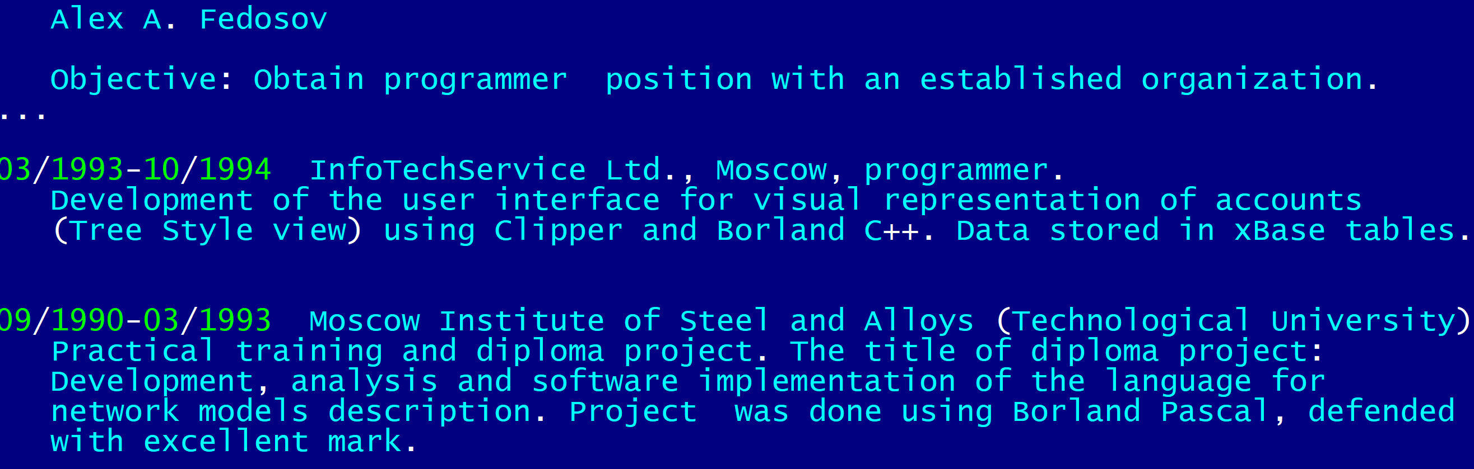
Be honest. Be humble. Be bold. AI and beyond.
Γνῶθι σεαυτόν / Know thyself
Not MLP/RNN

Slide 3
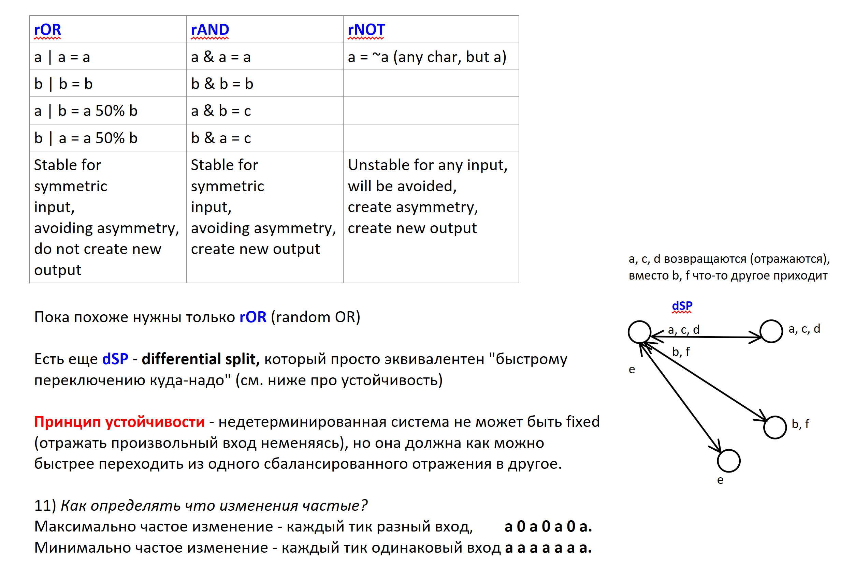
History. First idea. Fail.

Slide 4
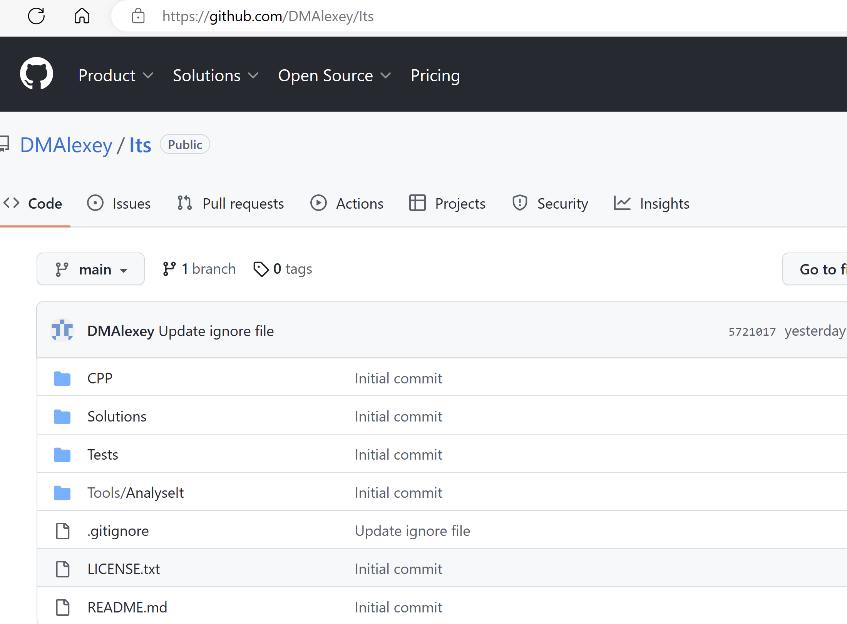
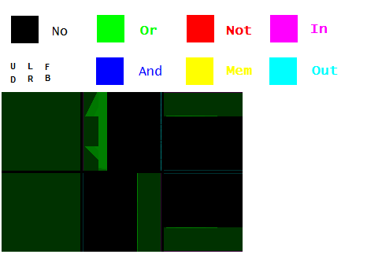
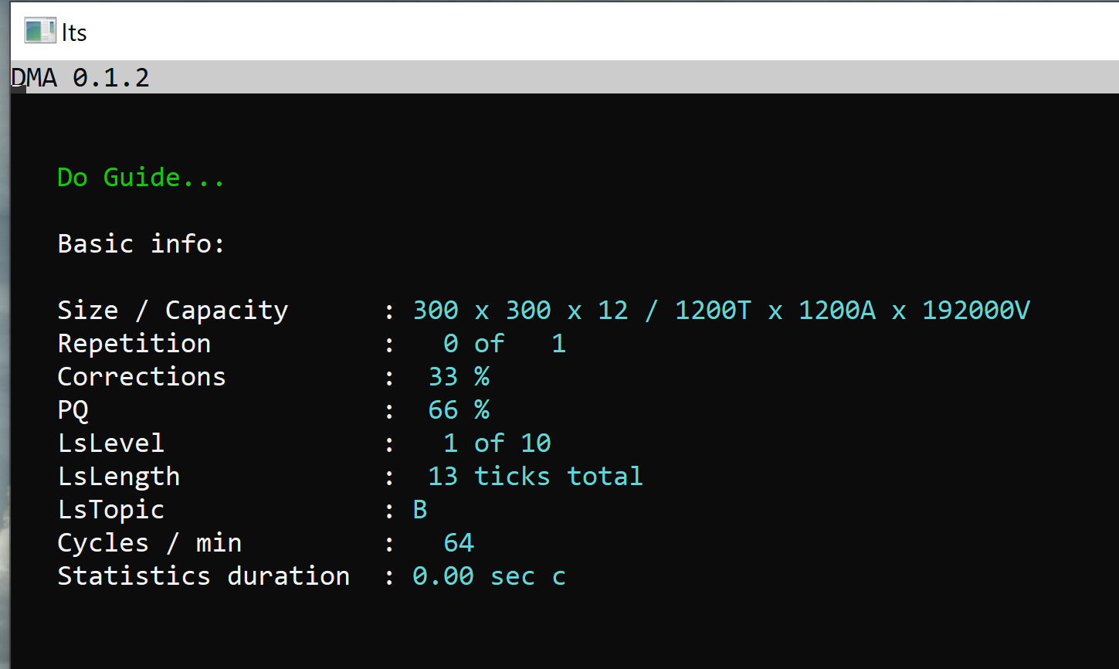
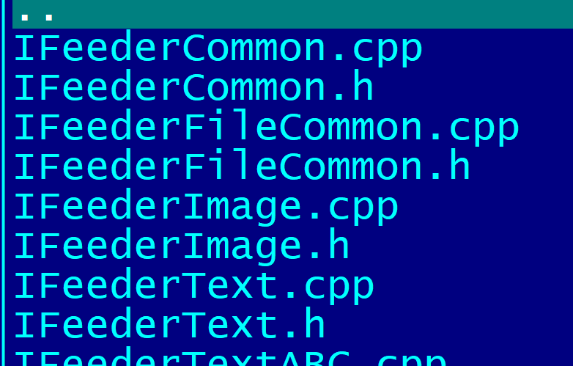
History. First idea. Fail.
The model is powered by Nvidia Cuda SDK / 12 GPU / SIMD
13 projects / 40k LOC / unit testing / demo

Slide 5
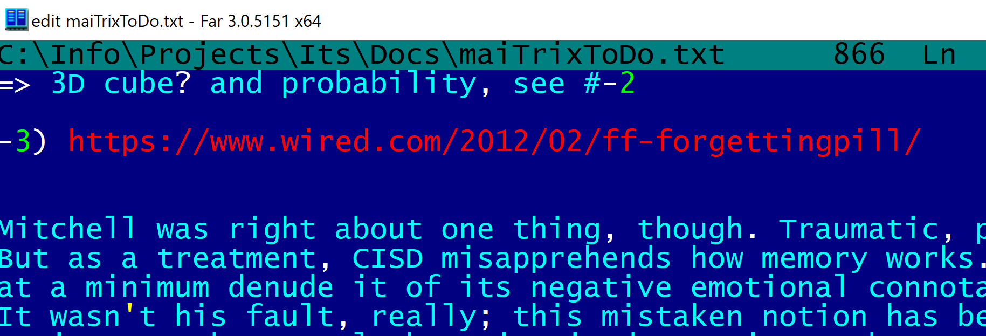
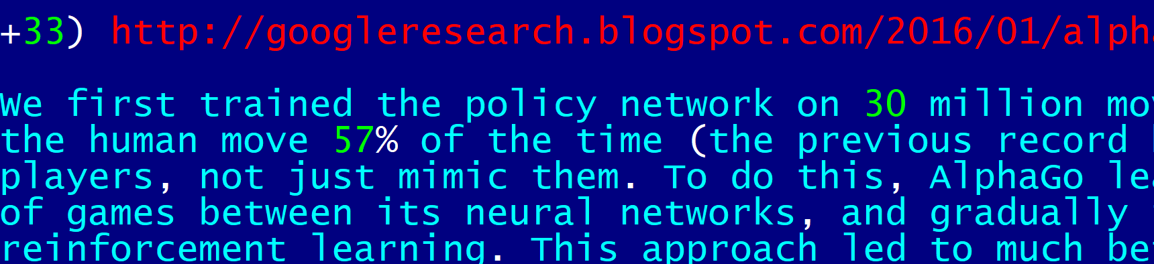
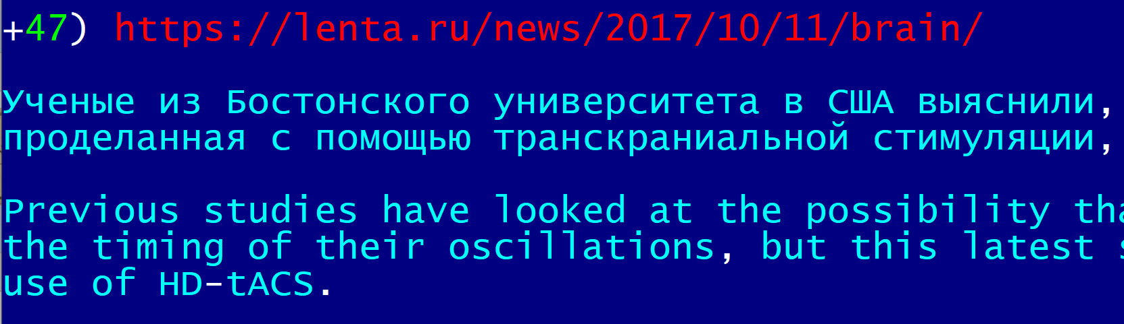
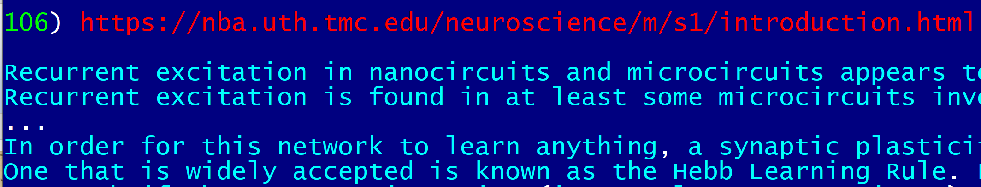
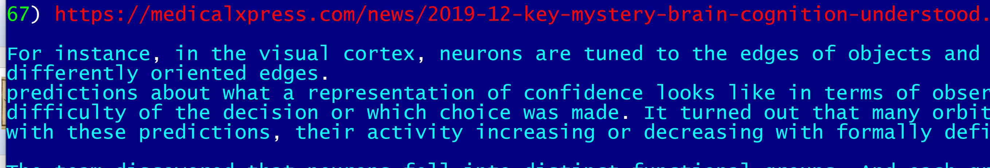
Back to basics. Bits and pieces.
10 years of sifting through facts, models,
white papers, abstracts of academic research papers & Thinking……….. remodeling…… thinking again
No AI experience. Is it good or bad? ;-)

Slide 6
Back to basics. What’s AI?
Given endless stream of data
Experiment, guess
And get confirmation or not
repeat
1T
Thinking – is doing
a single act of choice (bit)
based off a single piece of data (bit)
with a single piece of affirmation (bit)

Slide 7
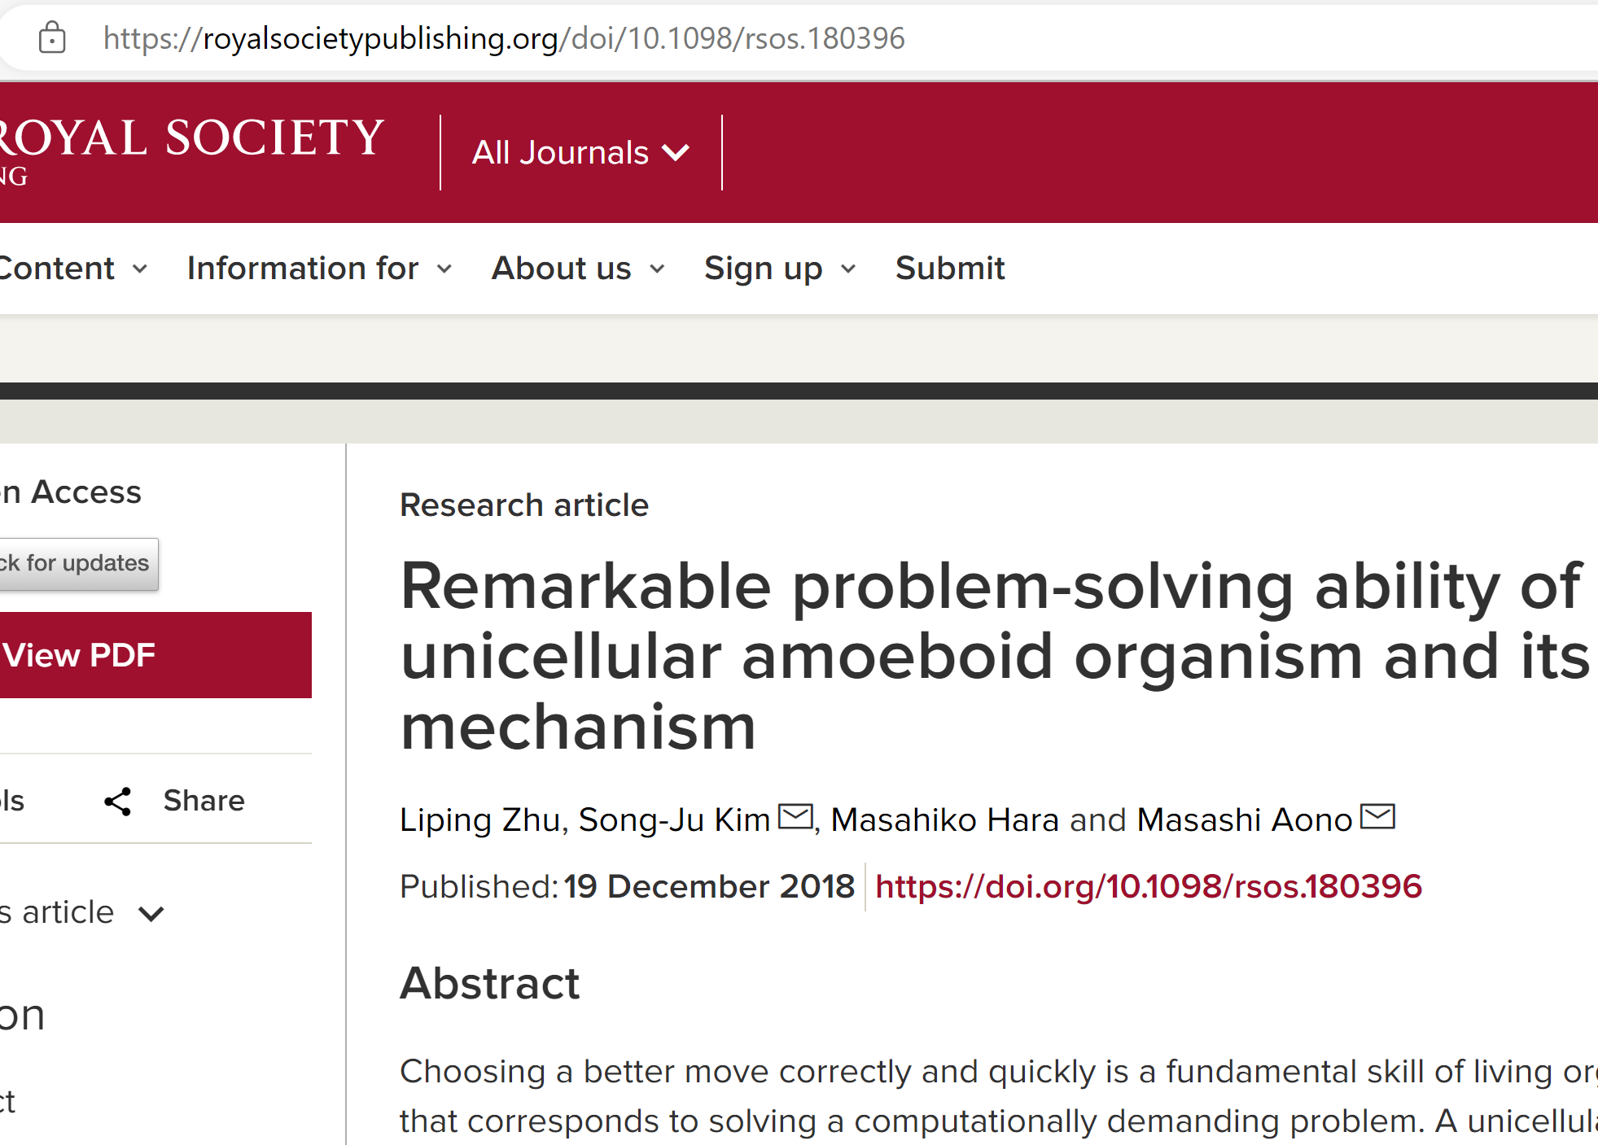
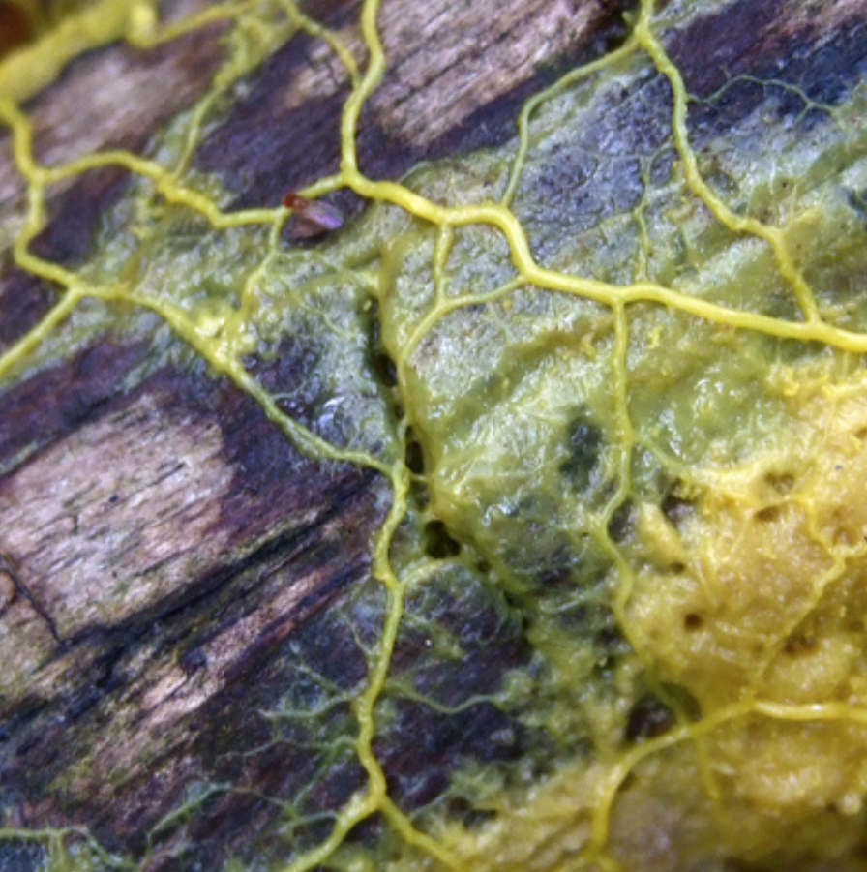
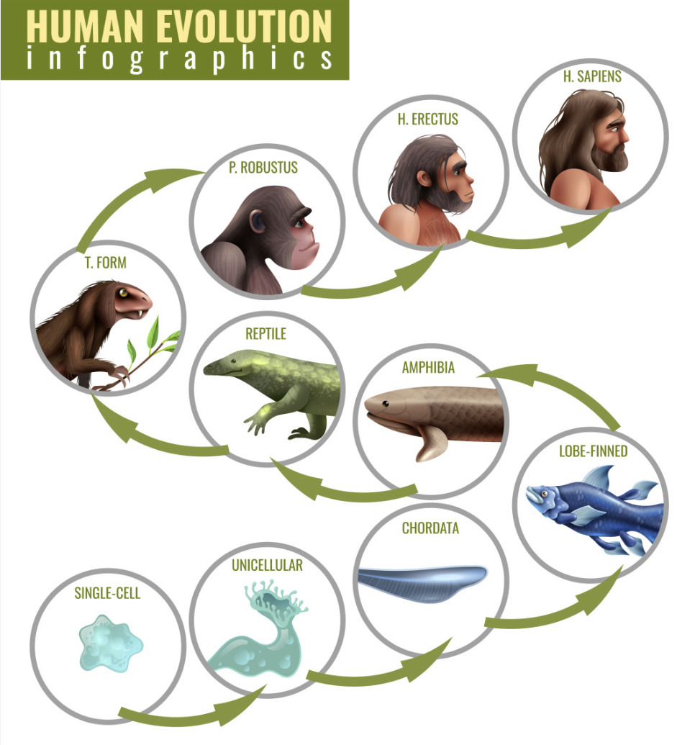
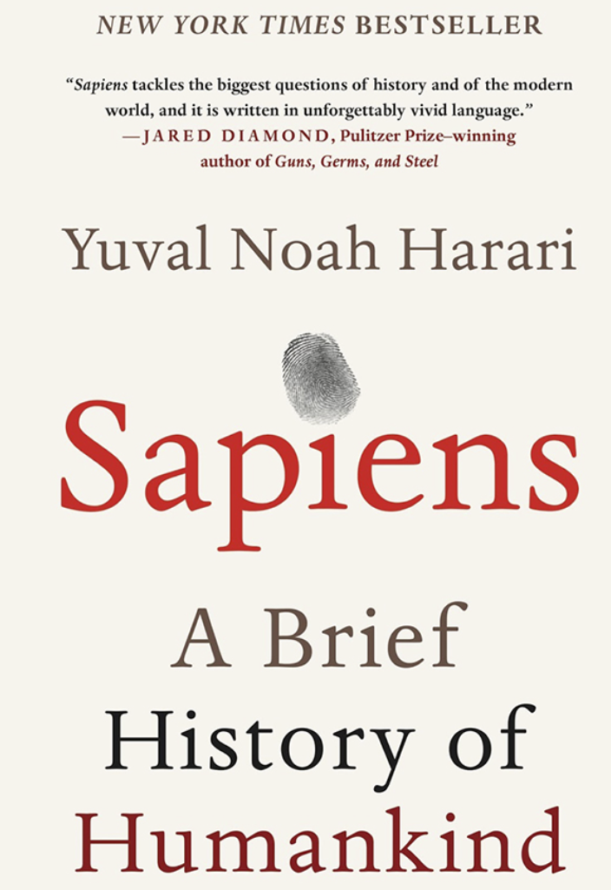
Back to basics. Physarum.
Physarum polycephalum can solve TSP (Travelling salesman problem, NP-hard) in polynomial time.
How?
Min efforts -> Max result

Slide 8
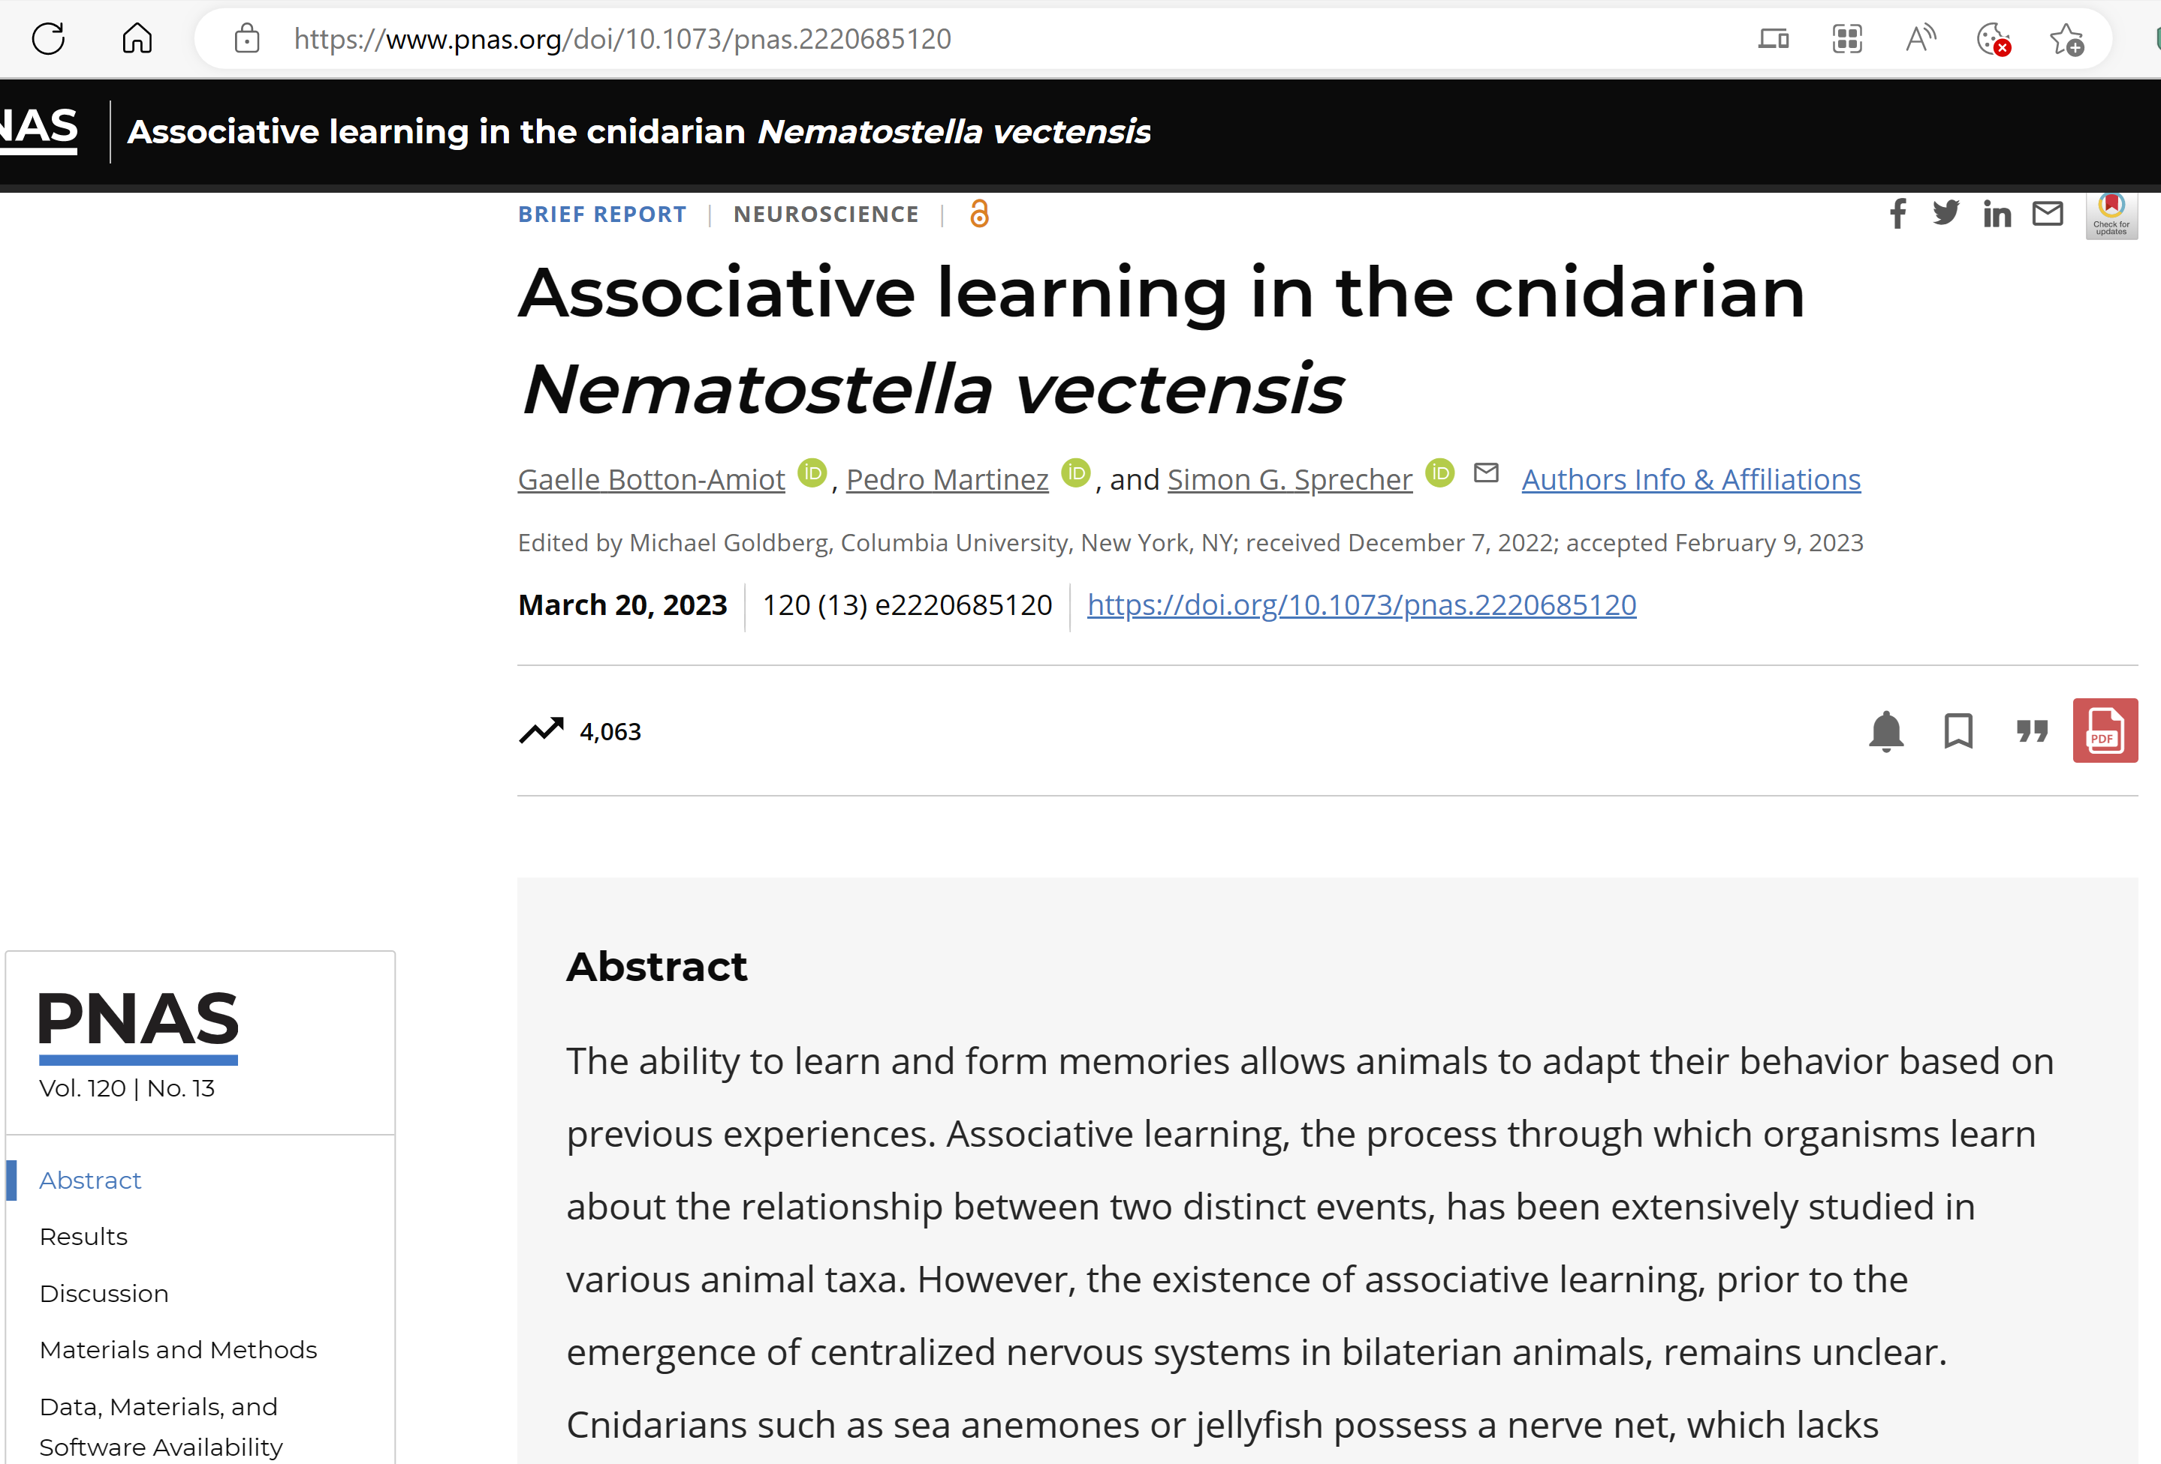
Back to basics. Associative learning.
“Besides shedding light on an aspect of cnidarian behavior, these results root associative learning before the emergence of NS centralization in the metazoan lineage and raise fundamental questions about the origin and evolution of cognition in brainless animals.”
Gaelle Botton-Amiot, Pedro Martinez and Simon G. Sprecher
How?
Associative learning?

Slide 9
Back to basics. Physarum. How?
Dig deeper. Stage 0. Pre-Physarum.
Random search. Ineffective but works, till now. AI level 0
Min efforts -> Max result

Slide 10
Back to basics. Physarum. How?
Dig deeper. Stage 1. Pre-Physarum. Invertor.
Random search with start/stop. More effective, works anywhere, evolutionary beneficial. Out with 2 speeds, inverted from In. AI level 1
Min efforts -> Max result

Slide 11
Back to basics. Physarum. How?
Dig deeper. Stage 2. Pre-Physarum. Tracking.
Tracking search with start/stop. Super effective, works anywhere. 2 Outs with 2 speeds, inverted from In. Both Outs work at the same time – physics, otherwise – spinning. AI level 1.5
Min efforts -> Max result

Slide 12
Back to basics. Physarum. How?
Dig deeper. Stage 3. Pre-Physarum. Spiral.
Tracking search with start/stop. 2 Outs with 2 speeds each, inverted from In with 2 controllers, analyzing short and long periods. AI level ∞
Min efforts -> Max result

Slide 13
Back to basics. Physarum. How?
Dig deeper. Stage 4. Physarum. Optimization.
Tracking search with start/stop. 2 Outs with 2 speeds each, inverted from 2 Ins with 2 controllers, analyzing short and long periods. AI level ∞
Min efforts -> Max result

Slide 14
Back to basics. Physarum. How?
Dig deeper. Why spiral is important?
Outward and inward tracking spirals effectively cover surface, approximating food search with min time solution. AI level - ∞
Min efforts -> Max result

Slide 15
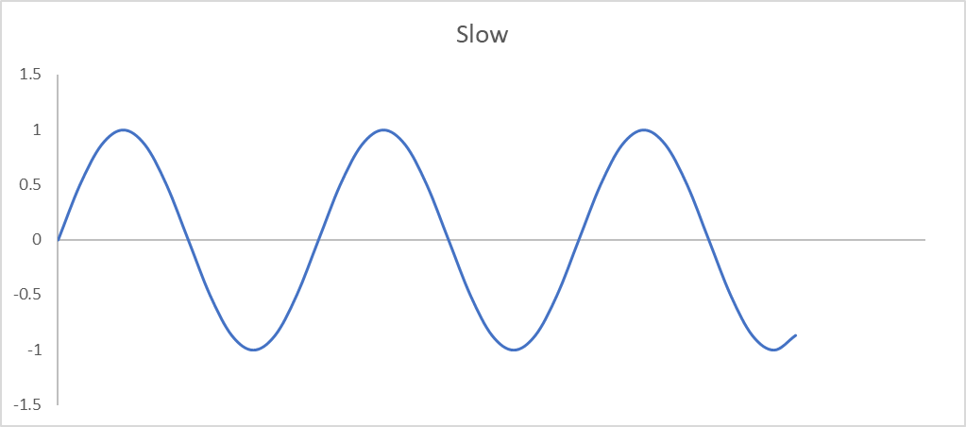
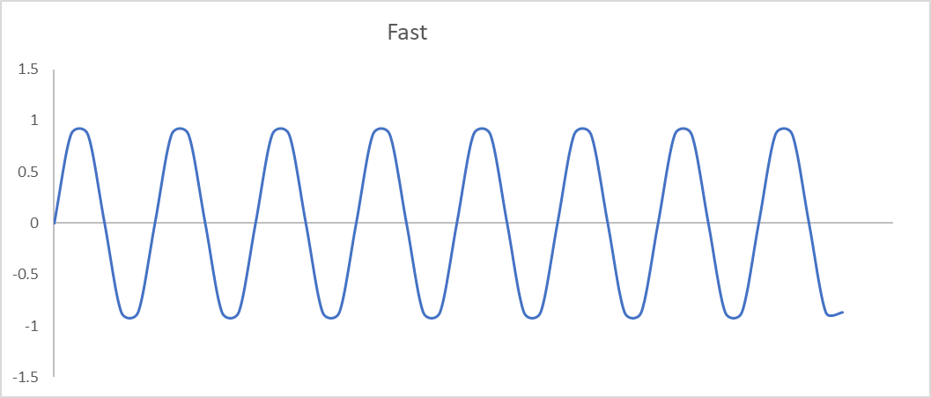
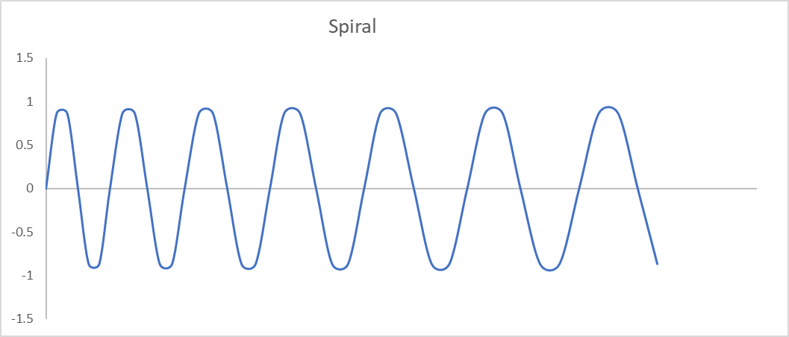
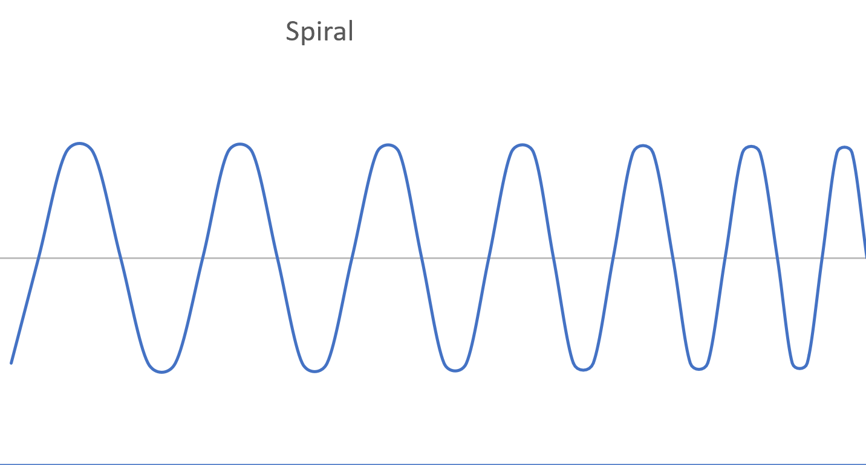
Implementation. Basics.
Optimization / evolution
Invertor Tracking Spiral Stereo
Freq F Freq S
Freq LFS Freq RFS
Freq LFS/LFS2 Freq RFS/RFS2
Same
Invertor – slow down when found something;
Tracking – not necessary LF=RF and LS=RS, this is not “spatial inversion”, but similar to Invertor, “temporal inversion” – slow down when found something;
Spiral requires continuous harmonics addition / subtraction;
Stereo – duplication, more resources, more effective;

Slide 16
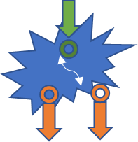
Implementation. Camertones. Important.
Getting signals with lower frequency (output frequencies, left/right, INV) | Getting signals with higher frequency (output frequencies, left/right, GEN)
Expected frequency 1,
10 signal / min (example)
50 10
1 5
Expected frequency 2,
100 signals / min
400 100
20 50
1500 1000
200 300
Expected frequency 3,
1000 signals / min
counterphase
Two variables – speed and differential (curvature), physics of turning

Slide 17

Implementation. Camertones. Important.
Lower density input => outward spiral
Lower input
frequency / density
Normal input
frequency / density
Higher input
frequency / density
Normal input
frequency / density
Higher density input => increased deviation
Model for optimal finding of the 1st degree symmetry (curved edge) and 2st degree symmetry (nearby edge)

Slide 18
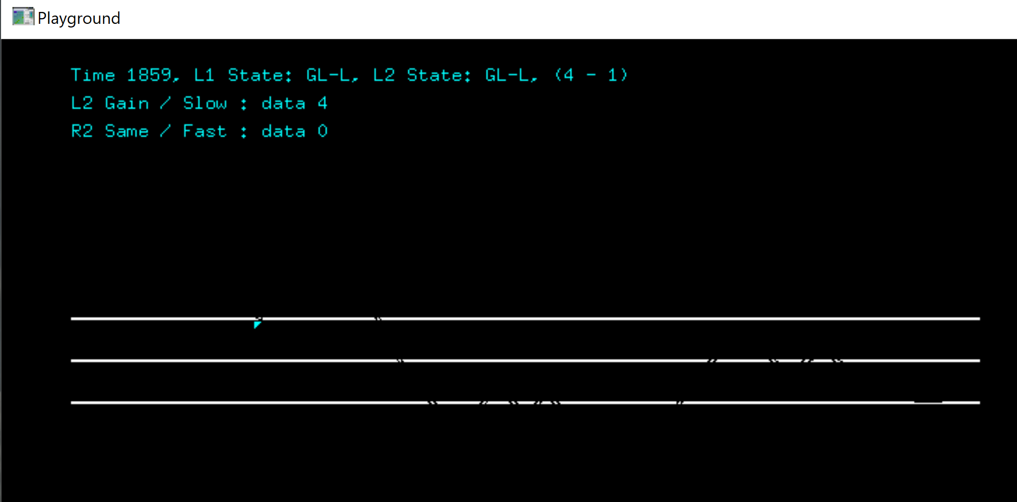
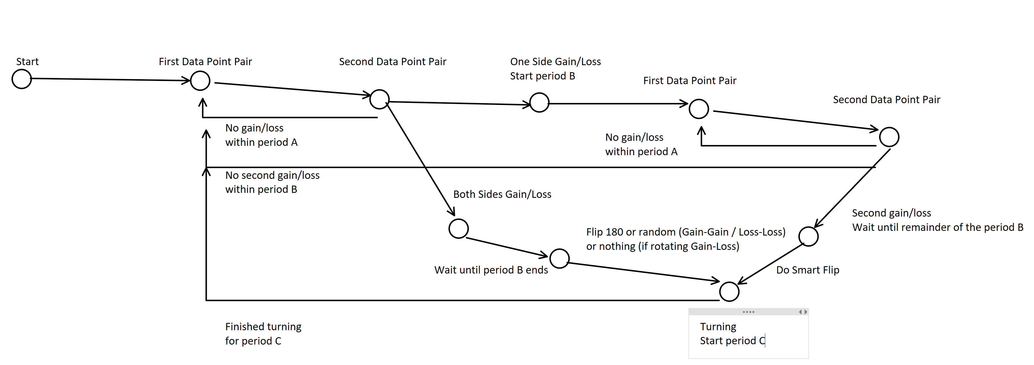
Implementation. Demo.
Tracking with 2nd level, “almost spiral”. Implementation – C++/OpenGL, state machine on both levels, 1k LOC, end-to-end testing.
Hypothesis: Multi-leveled tracking spiral is sufficient solution for the main task on all AI levels “Min efforts -> Max result”, which is NP-hard and beyond.
Question:
Is this elementary implementation? No.

Slide 19
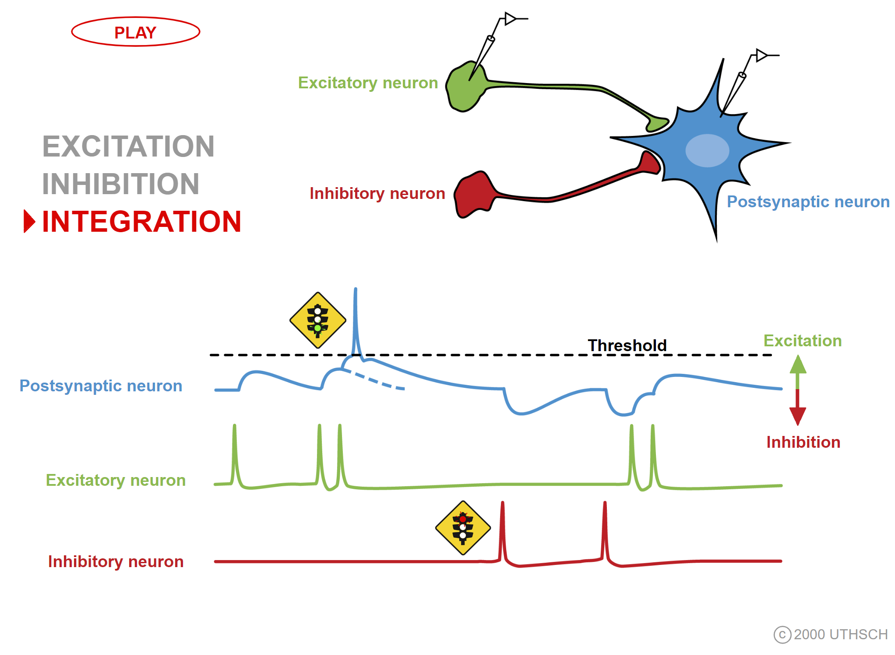

Implementation. Elementals.
(GEN)
Cell
Random search, non-stop
Freq fixed,
few base “tones”
(GEN start/stop)
Cell
Call them GEN too as all generators should be stopped anyway
Freq fixed, start/stop
(INV)
There are a few precise models for neurons;
Feedback delay may vary, affecting frequency but not too much, otherwise it can’t be stopped;
Feedback delay may be != Input delay, thus generation frequency may differ from reaction frequency;
Cell
Smart search, start-stop
Freq inverted

Slide 20
Implementation. Genesis.
In
Out
In
Out1
GEN
GEN
INV
Out2
INV
Better invertor implementation
“Almost tracking”
(TRK)
In
Out1
GEN
Out2
Few interim (evolutional) implementations omitted for simplicity;
Timing is the key;
Not reacting to signals, but to absence of signals within certain period;
Reached Physarum AI level? Maybe!
There’s a catch – won’t work for low frequency signals as “long-long-long delays” are way too costly and we couldn’t stops even if we had it. How to solve?
GEN
Out2
Out1
INV
INV
Tracking,
implementation by duplication,
phase reversed

Slide 21

Implementation. Camertones.
3 bits / sec
(CMTN)
GEN 1 freq. 1
In
Out
5 bits / sec
GEN 2 freq. 2
Cell
7 bits / sec
GEN 3 freq. 3
(1/105) bits / sec
………
(GENS/INVS )
GEN 1 freq. 1
See slide #15, GEN frequency can very, but not much;
Timing is the key, obertones intersection;
Frequencies should not necessarily be prime numbers, but better be pairwise prime;
Think of CMTN as a slow GEN / long delay;
But there’s another use for it, see next slide;
In
Out
GEN 2 freq. 2
Cell
GEN 3 freq. 3

Slide 22
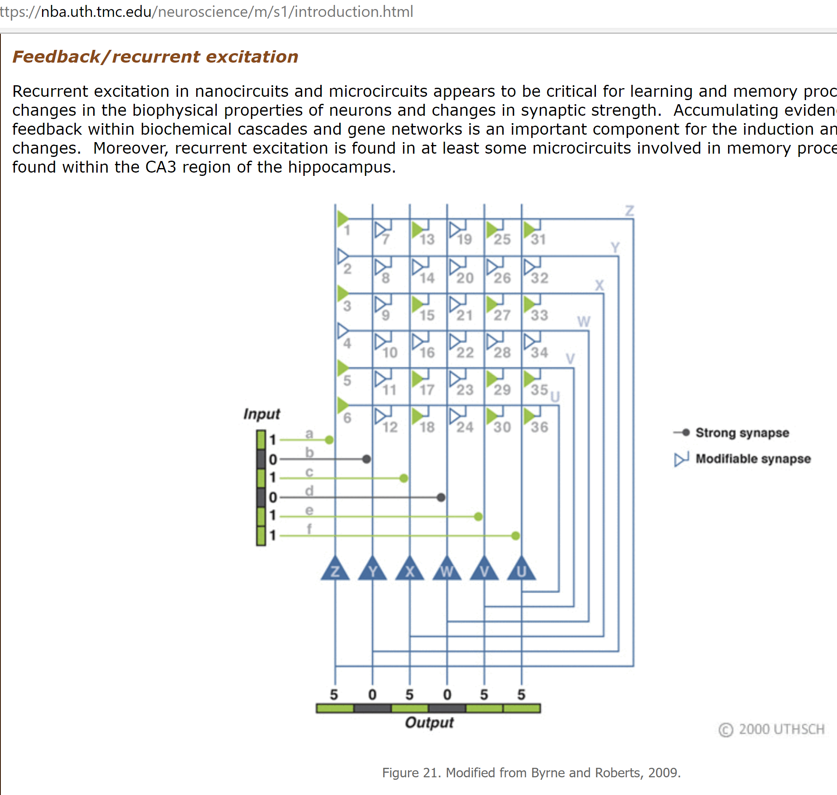
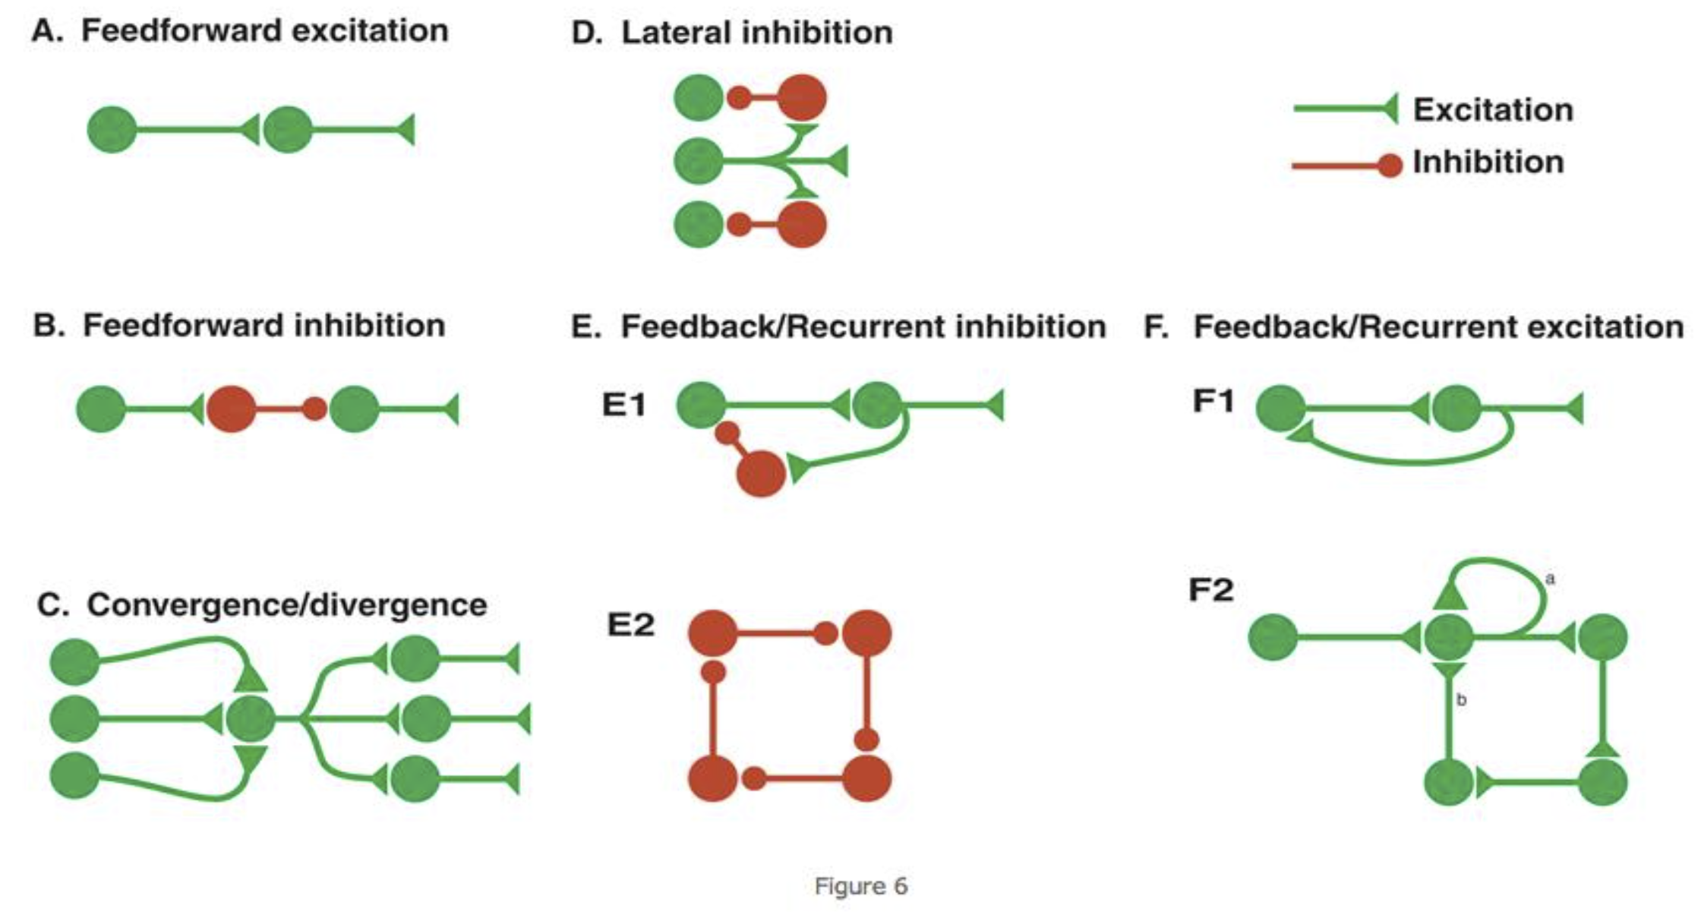
Implementation. Magic.
(CMNT)
CMTN can either be slow GEN or slow INV depending on plasticity level:
1
Cell
2
1) GEN when delay ~= refractory period and #1 is prioritized per Hebbian synaptic learning rule (STDP), meaning as we start generation we ignore #2 for the delay period. Note that GEN must be stopped at some point (‘-’ not shown for simplicity);
In
Out
1
Cell
Cell
2
2) INV when delay >> refractory period and #2 is prioritized per Hebbian synaptic learning rule (STDP), meaning we’re restarting generation again and again, ignoring #1 for the delay period;
Cell
1
2
Neuroplasticity (LTP/LTD/STDP),
sAHP, “spike frequency adaptation” Delay & refractory period, time before can be triggered again.
Magic? Music!
Again, timing is the key;

Slide 23
Implementation. Final.
(TRKS)
GENS 2
Tracker, see slides #13 & 16
works the same way, but speed as slow as required
Phase can be balanced as required
Each dual-part of the tracker is tuned to its own incoming frequency/tune and generating two pairs of stable output frequencies, one for positive income and another for negative, absence of income.
Out1
GENS 1
In
INVS 1
Out2
INVS 2
But how do we know what’s required?
Get back to slides #12-14 and rethink it.
INVS 2

Slide 24
Implementation. Requirements.
But how do we know what’s required? Get back to slides #14-15 and rethink it.
We need to find patterns and with this multi-level spiral tracking we can find patterns of 1st symmetry level, 2nd level, etc! And why do we need patterns?
Min efforts -> Max result scalable
We encode/model/change our surroundings/environment by changing our topology, adding/removing INVS/GENS based on result of every min experiment, see slide #6

Slide 25
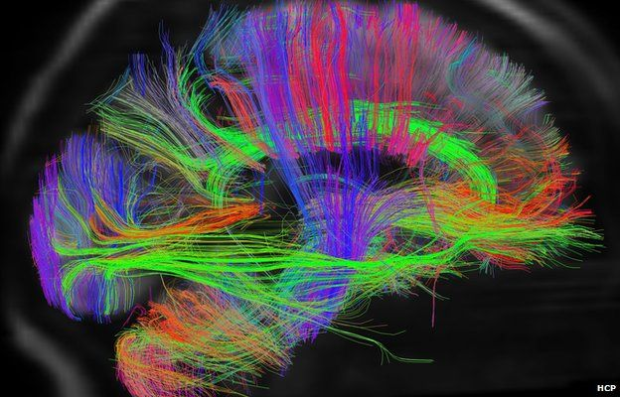
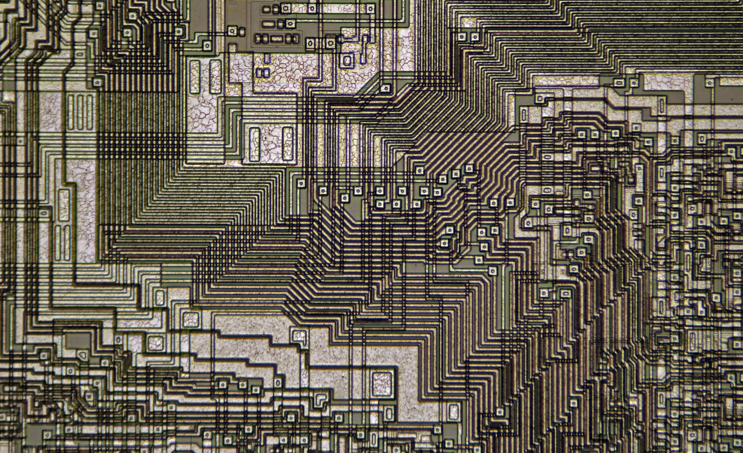
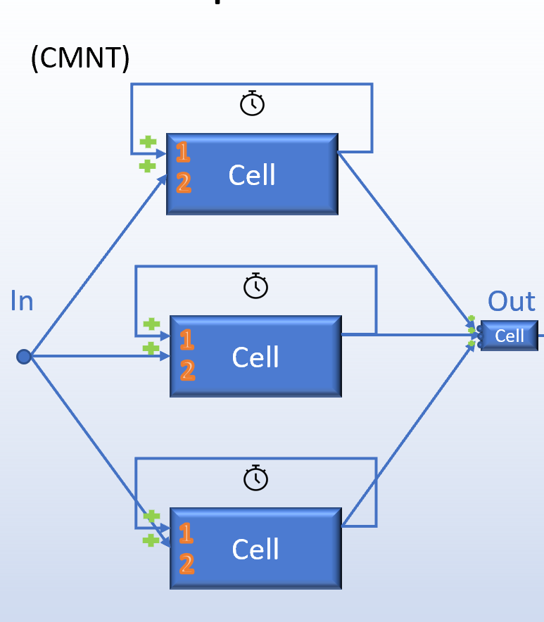
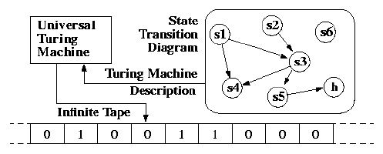
Why so simple?
Connectome
Camertones
CPU
Turing Machine

Slide 26
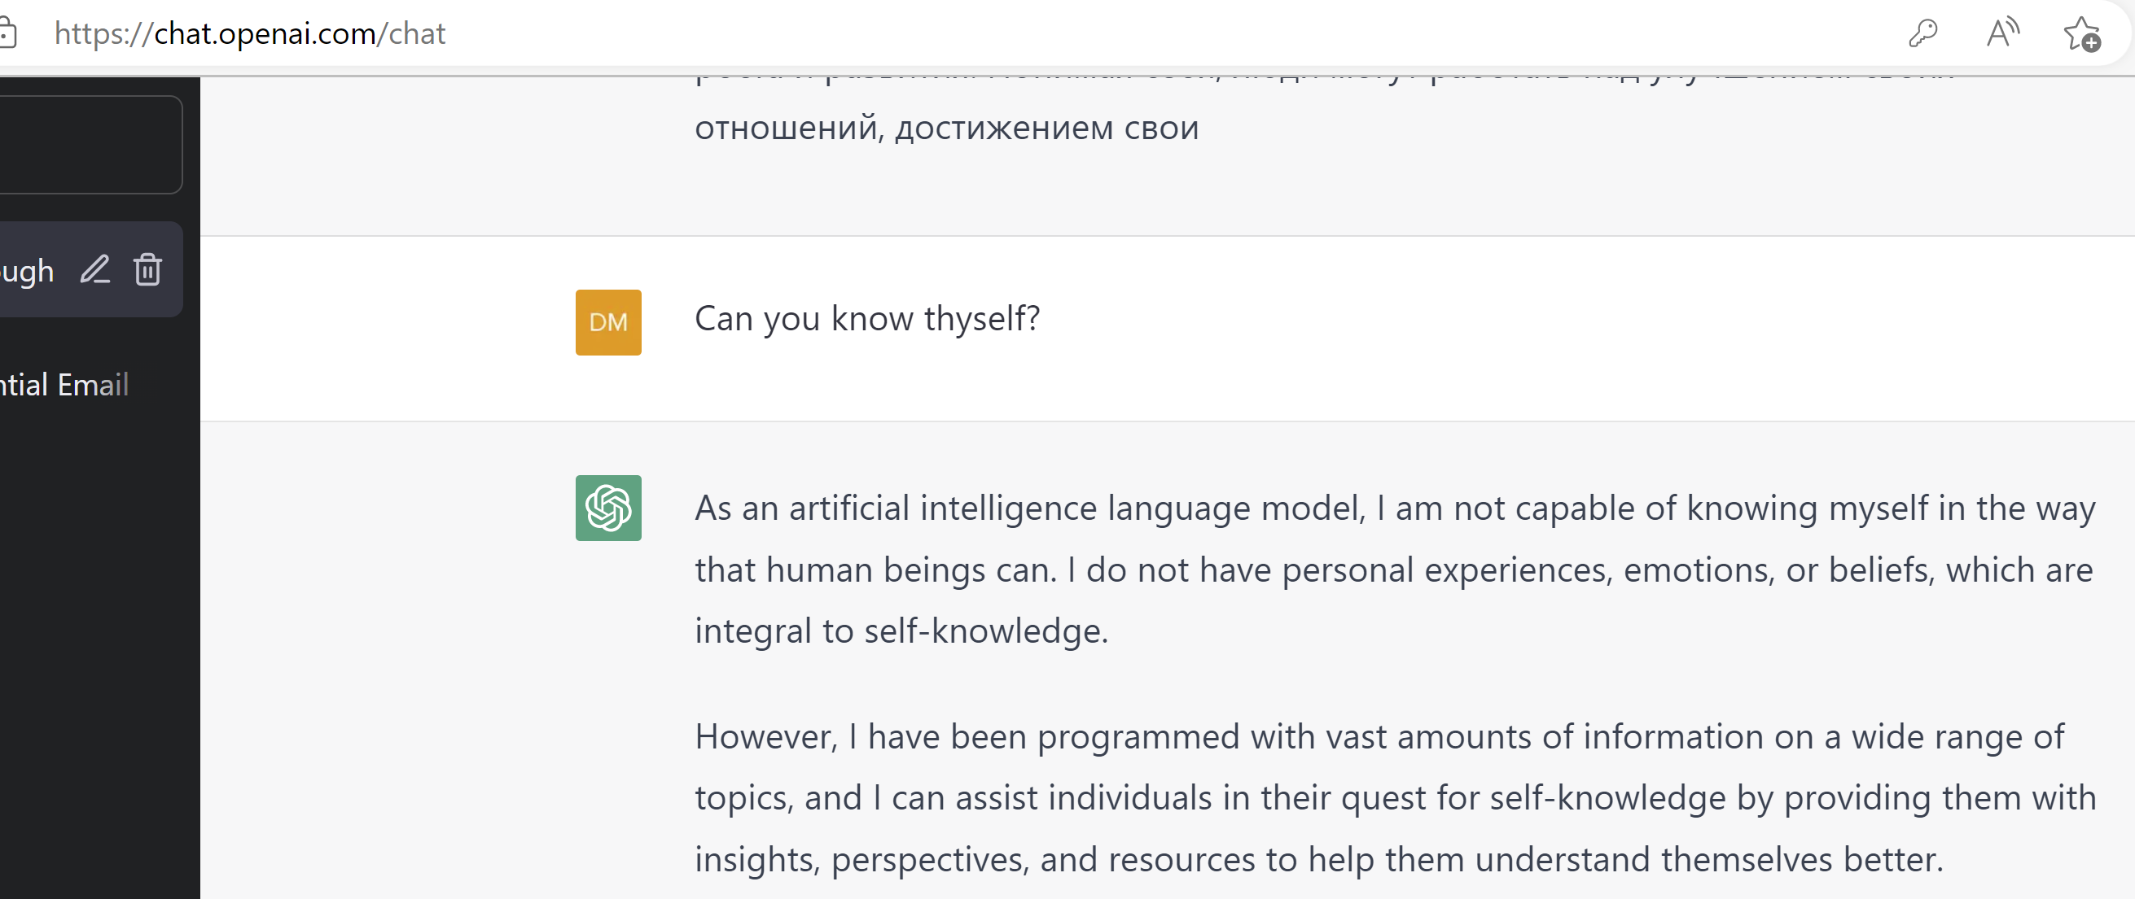
Back to the future
Valid answer. But can we do better than LLM/parrot-fashion models? ;-) Yes, as decomposition complete we can start building from bottom up complex math models on solid foundation, Natural Neural Network, NNN.
Be honest. Be humble. Be bold.

Slide 27
Addendum. Summary.
This has been decomposition process down to cross-level unified elements, “Lego”. Composition is yet to come.
It’s is not reactive, but proactive (spiral), thus it has free will by design.
Thinking is doing.
Its dead without needs.
Timing is essential.
Interaction is the key. No force-feeding, let it live.
Never train prematurely. Do not train if you can self-train.
The system is non-linear, sensitive to small ‘base rule’ changes as all DNNs, however stable and resilient to any inputs if implemented correctly.

Slide 28
Addendum. Alternative design.
(TRK/TRKS)
(TRK/TRKS-2)
Out2
GEN 1
GEN 3
GEN 1
In
INV 2
In
Out2
Out1
Out1
GEN 3
GEN 2
INV 4
INV 4
Lower level - phase reversed (physics),
Higher levels - depends
Number is frequency
Other topology is possible but seems unlikely and timing is a bit off (what is important), subject to QA, fuzzing tests

Slide 29
Addendum. Optimization.
(TRKS-O)
(Long )
GENS
GEN 1
In1
Out1
3
This is one half implementation;
Provides better tracking;
Genesis is rather straightforward;
Delays are very finicky at low freq. and seem to be optimization too, better be replaced with open triggers, reacting to sequence of events;
GEN 2
In2
Out2
2
INV 3
(TRIG-O)
In1
1
GEN
INV 4
Out
Cell
In2

Slide 30
Addendum. Classification.
Model | Positive | Negative
Algorithmic, traditional Turing model | Very precise and cover wide range of tasks | Require human participation in design and development
ML, deep-learning (CNNs, LSTMs, GANs, SOMs, etc.), too many algorithms exist, meaning no one is a good one | Already mainstream and while not precise but practically suitable for certain applications, domains | Require human participation in design; Models are very complex (>1B variables in the best models); Require training, expensive;
Quantum computing | Suitable for certain applications, domains, under development | Very expensive
Hardware evolution reimaging John H Conway’s “The Game of Life” with FPGA (Adrian Thompson, et al) | “From bottom up” solution, under development | Under development
Camertones, DL arithmetic-based model | “From bottom up” solution, no training needed, cover all domains, inexpensive | Not validated

Slide 31
Addendum. References.
Thesis | Positive | Negative
Cemi field theory | Integrated information must be physically integrated, EMI. | Synchrony, timing misunderstanding.
Essential attributes of the neocortex | Learning by rewiring, sparse distributed representations, and sensorimotor integration. | True requirements, but not sufficient conditions.
Hardware evolution | Practically useful evolved circuits are in sight. | Still under development, basic “Lego” elements are not formed.
Dynamic logic algorithms | Logic limitations have been overcome in dynamic logic. | Too high level, from top to bottom design.
Physarum polycephalum solves TSP | Confirms practicality of the nature’s based logic. | Not scalable, wrong underlying model.

Slide 32
Addendum. Open Questions.
Question | Answer
Re. CMTN as GENS (#18), how would the “end cell” affect it? | It would prevent any Out if events coincide (obvious, bad thing?); It would prevent first Out what is useful if GENS are being used as a long delay and good way to prevent “cross-level” initial pitch; Collisions may be very rare and ignored (TQA); Better keep it for symmetry as GENS <=> INVS may be at some point;
Main continuity theorem (not postulate): If the set of rules works for “min system“, it will work for “big/any system“ as well. | Experiment Any multifactor optimization system can be reduced to two-factor optimization system (rephrasing, not proving ☺). ???
How to find all composite/”long” frequencies given a few basic ones? | Simple application Math (arithmetics)
Confirmation that we can produce spirals at any frequency level. | Use convergence of series theorems

Slide 33

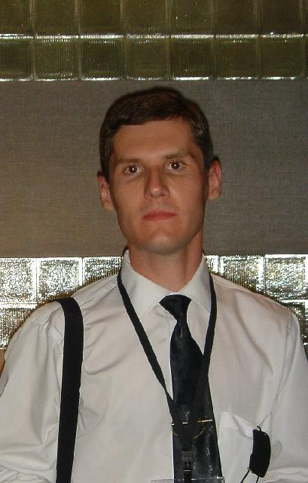
Addendum. Customer Discovery.
Its
Its time to move forward with free AI answering to all your needs.
Alex Fedosov

Slide 34
Addendum. Customer Discovery.
Who |  | Why
Everyone | All data driven processes | AI-driven solution can benefit to any business, person or process. Alternative to closed proprietary solutions. All open source solution benefits applies. Free.
 | Digital economy
 | Science
 | Medicine
 | Business

Slide 35
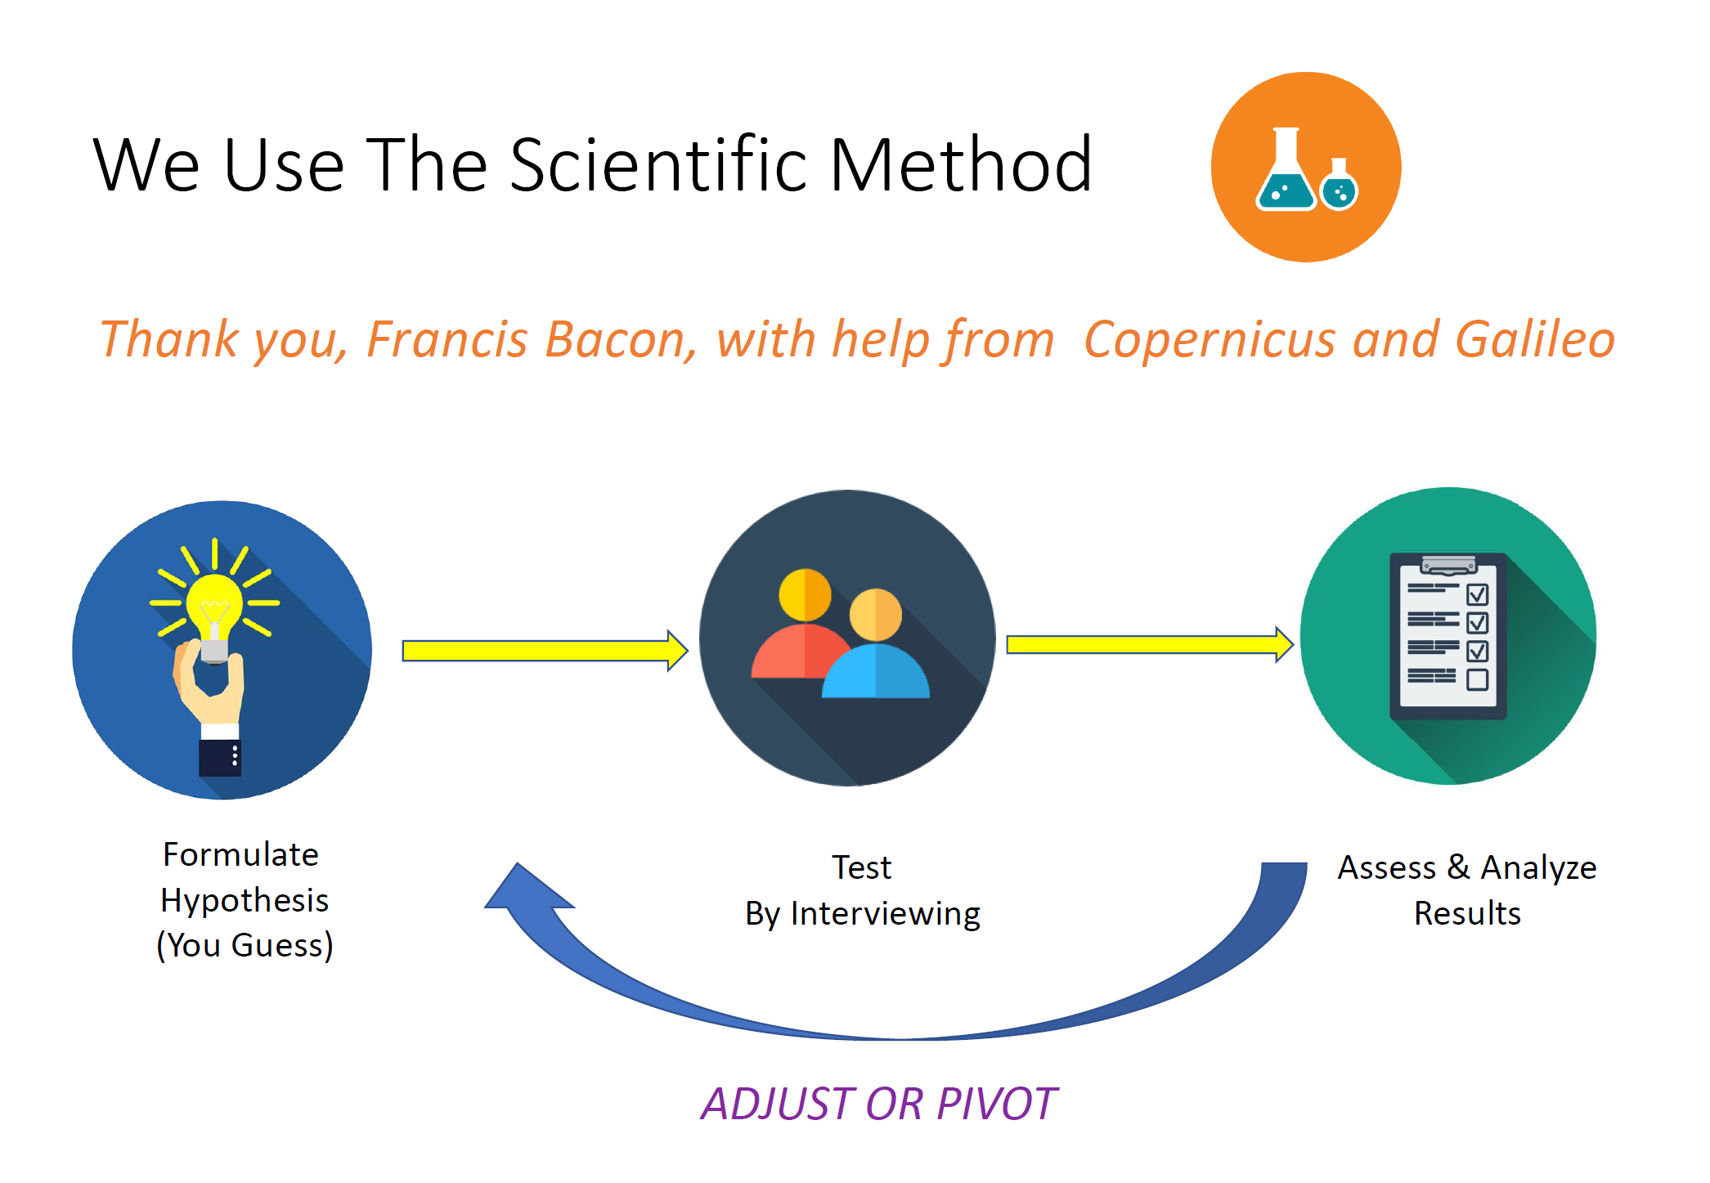
Addendum. Business analogy.
Matt Lukens

